Slide 1

Exploratory Data Analysis
G2M insight for Cab Investment firm
5/15/2023

Slide 2
Problem Statement
Main objective is to provide insights to help XYZ identify the right cab company to make investment.
Questions that will be discussed:
Customer segments based on gender, age, and payment method with profit difference
Company comparison regarding users and margin profits
Profits regarding seasonality and customer size

Slide 3
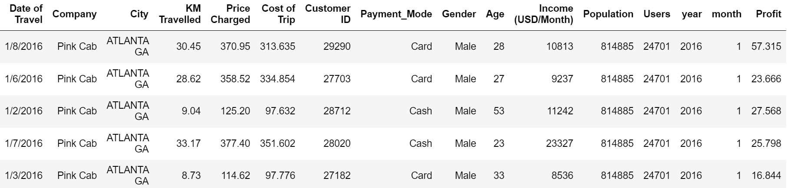
Data Exploration
Datasets are comprised of 17 unique features and more than 350,000 data entries range from 31/01/2016 to 31/12/2018.
Year and Month variables are extracted from Date of Travel to be used in finding trends in seasonality.
Profits are calculated using Price Charged and Cost of Trip for each transaction

Slide 4
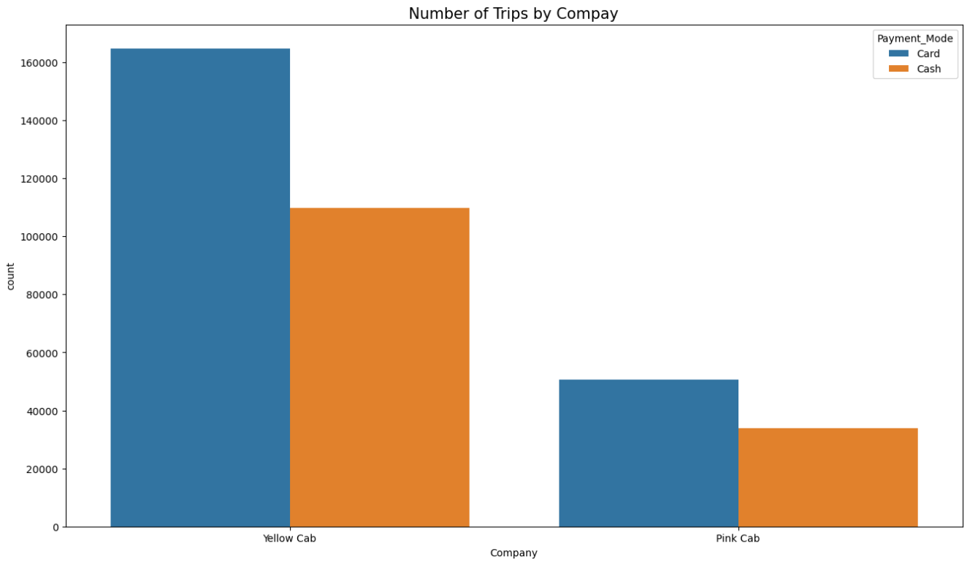
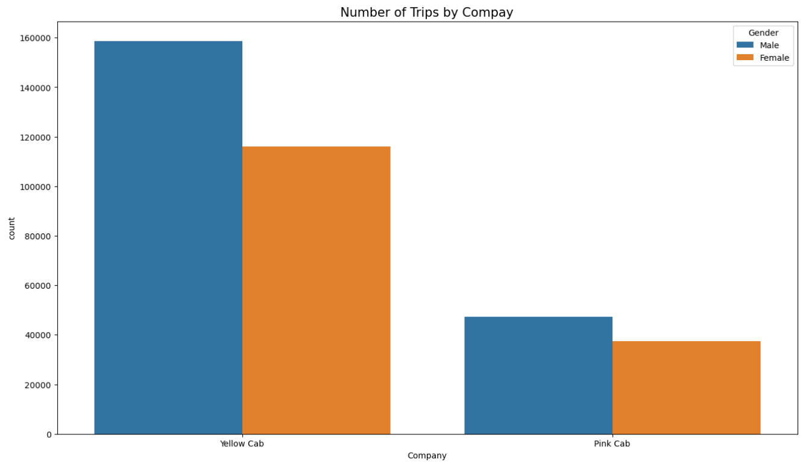
Company Analysis

Slide 5
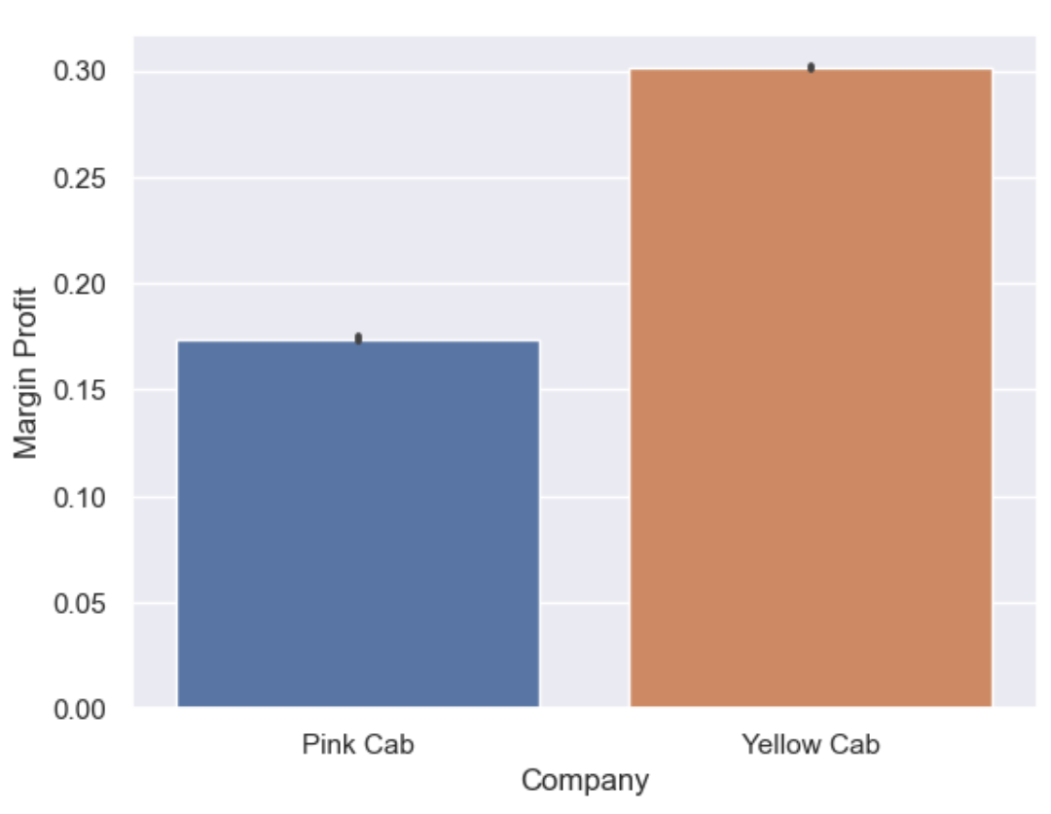
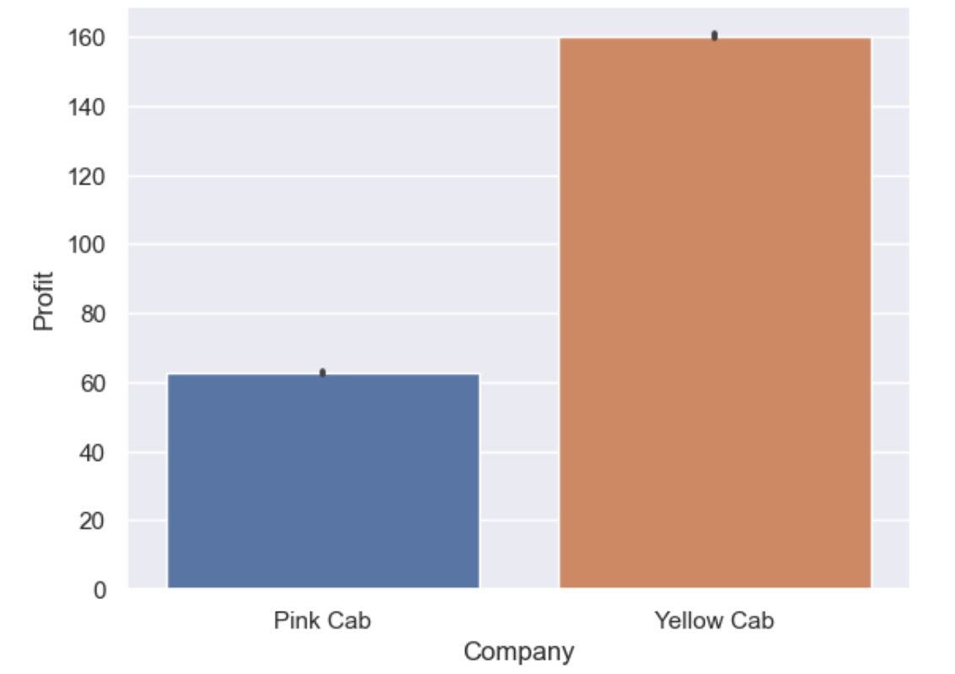
Company Analysis
Company: | Pink Cab | Yellow Cab
Average Profit: | $62.65 | $160.26
Average Margin | 17.4% | 30.1%

Slide 6
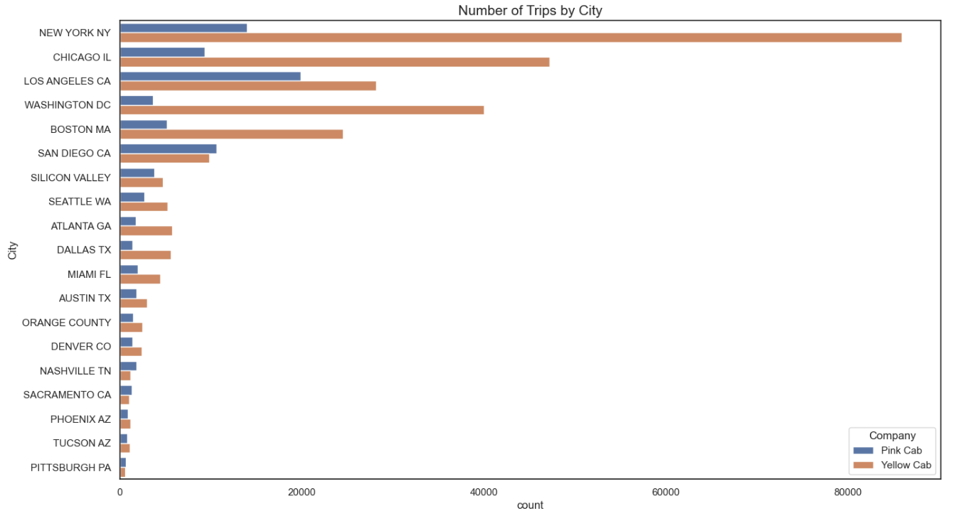
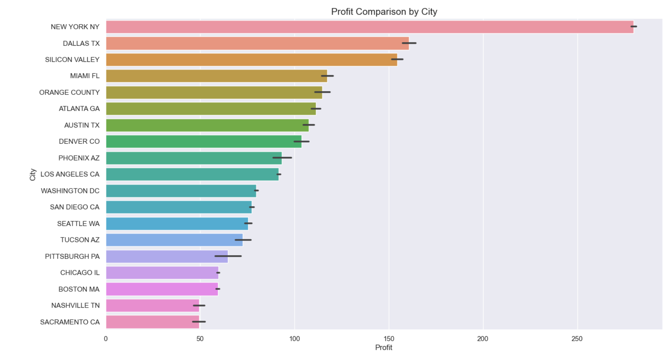
Geographical Analysis

Slide 7
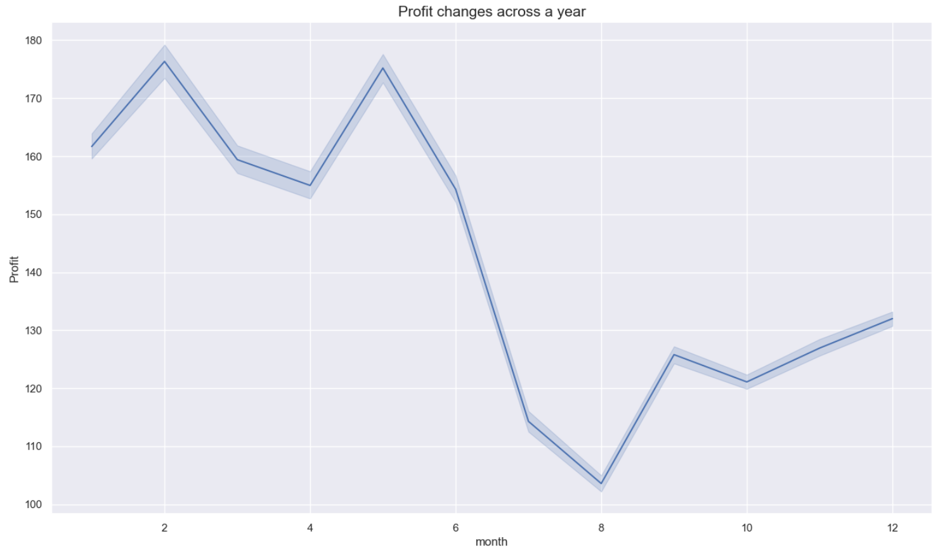
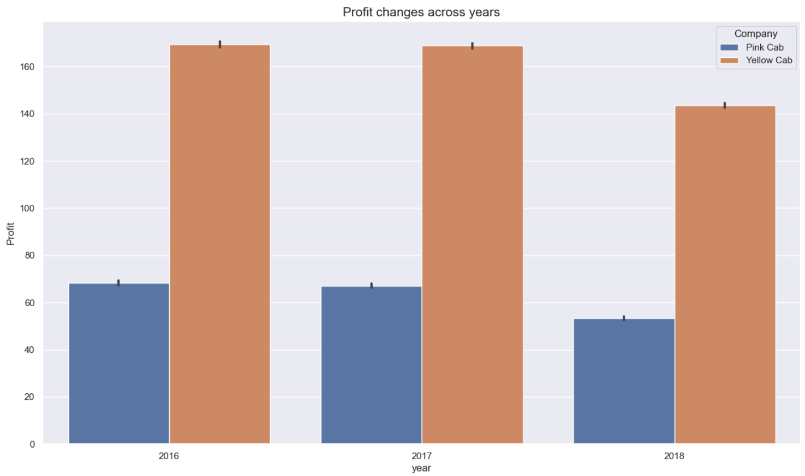
Seasonality Analysis
Profit drops were observed both during summer season and during 2018.

Slide 8
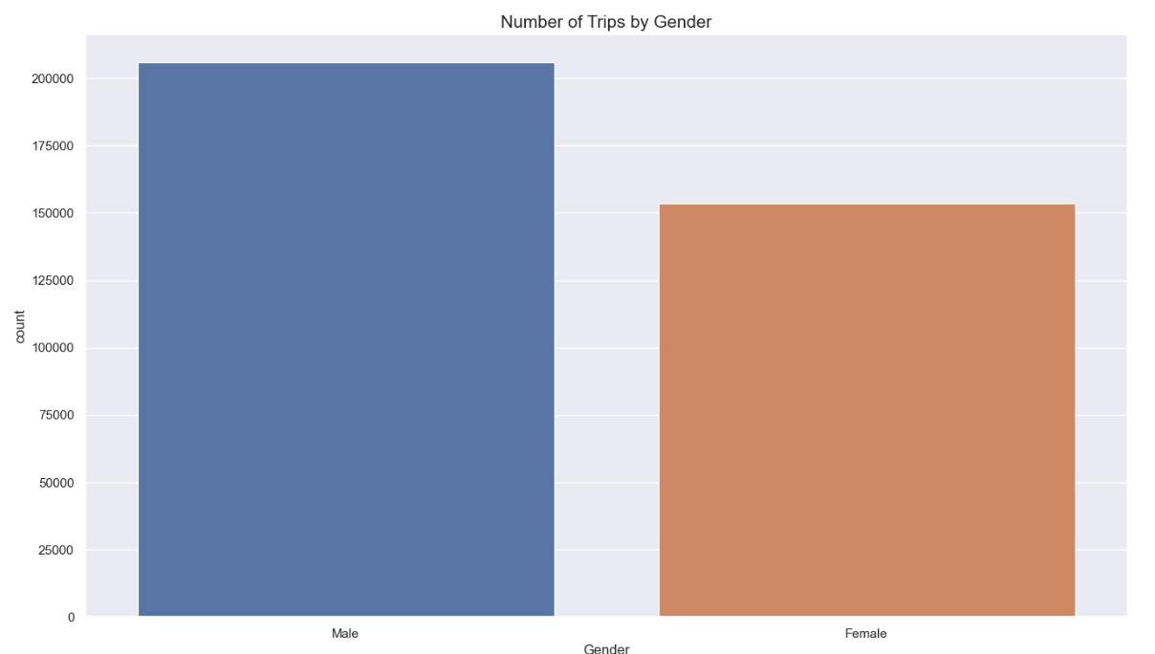
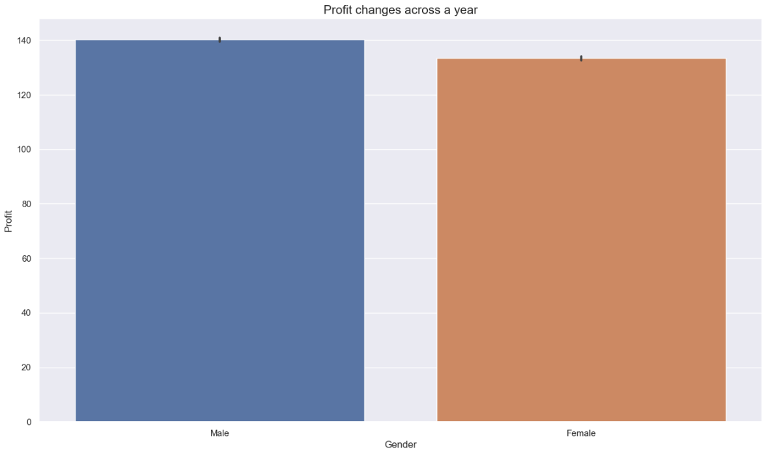
Customer Analysis
Male customers have more trips than female customers, and slightly higher profits than female customers

Slide 9
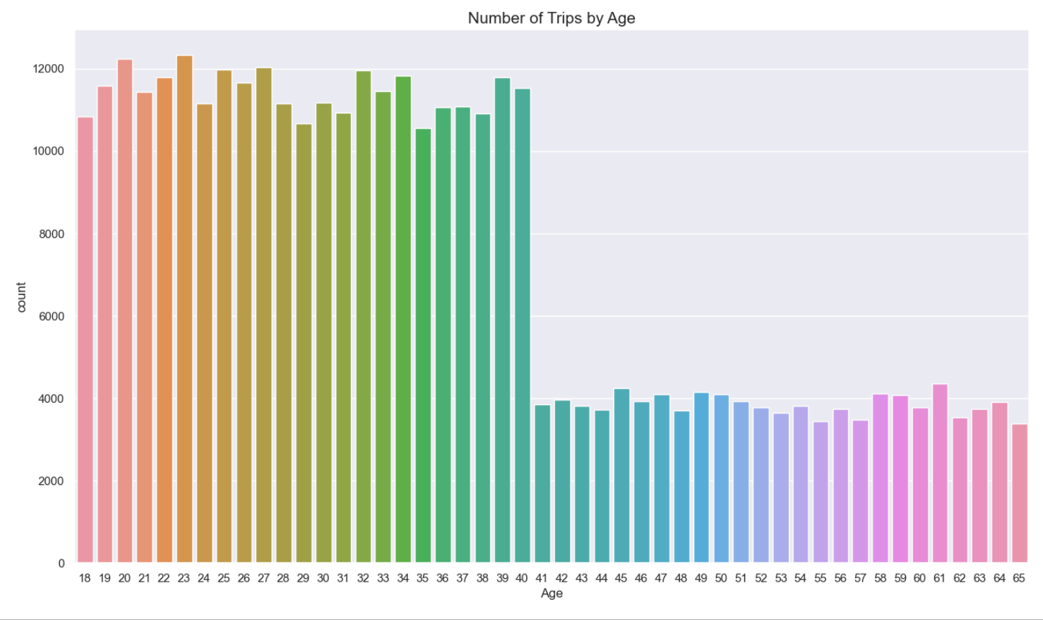
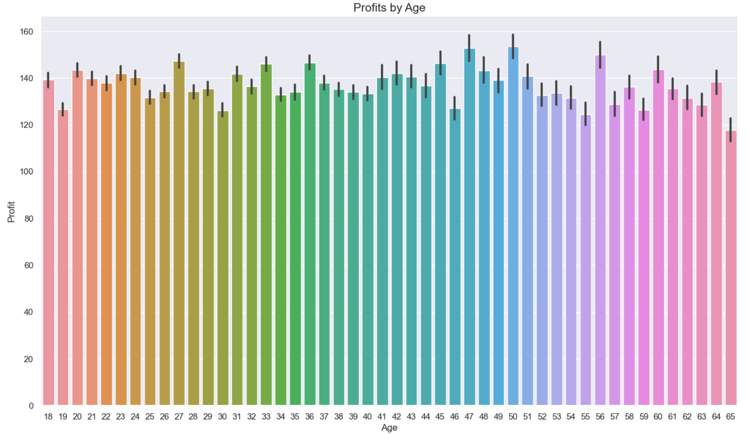
Customer Analysis
Younger Adults have much more trips compared to older adults who are older than 40 years old;
There is no big difference in profits among different age groups.

Slide 10

Recommendations
Yellow Cab Company produces higher margin profits, so investment in yellow cab firm will likely bring more benefits
Profits of trips drop dramatically in summer seasons in general, it’s recommended to invest in the other time during a year.
Male customers tend to bring more profits than female customers, advertisements could be targeted more towards male user groups.
Number of users are correlated with the average profit amount, so investment in cities with larger user base would be recommended

Slide 11
Thank You!

